Slide 1
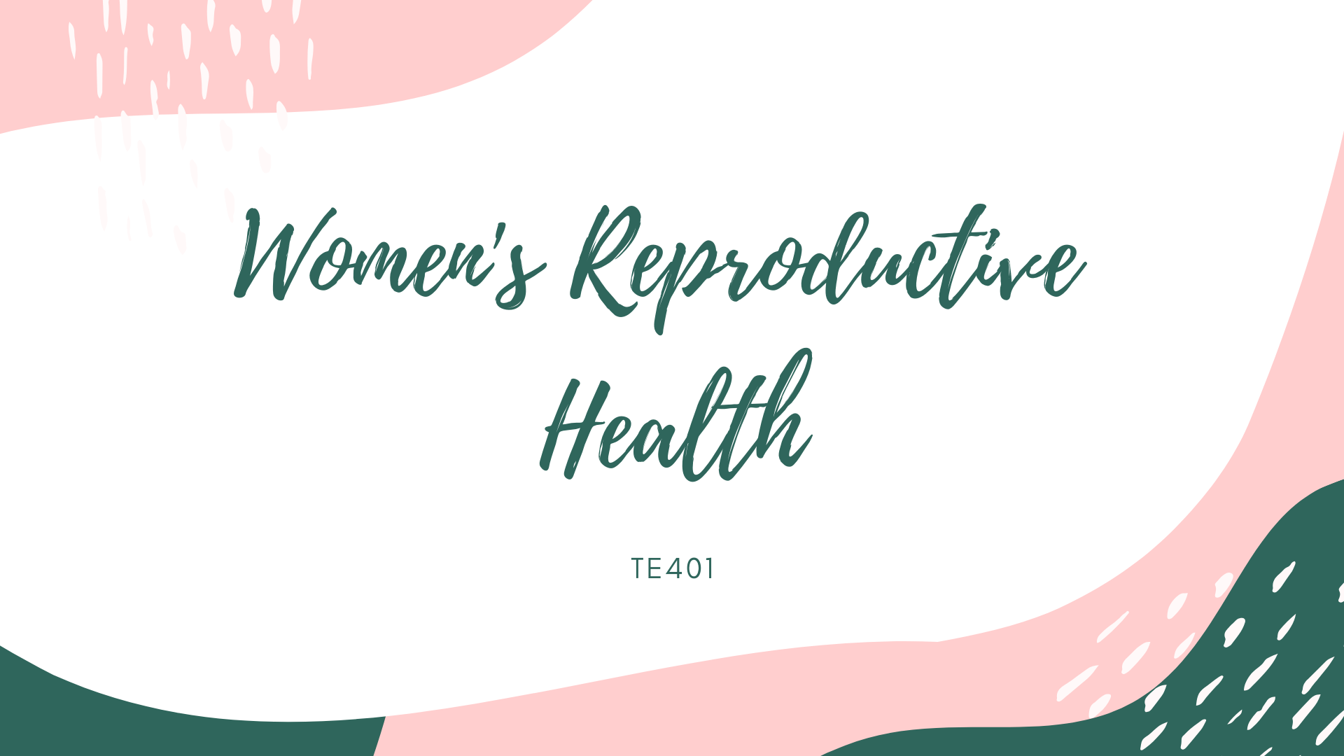

Slide 2

Conducted survey of 74 people
Narrowed down audience based on responses
Narrowed down topic
Notes:
Last week, we conducted a survey of 74 people that gave us an insight into what concerns people had about menstruation and what factors determined what type of product/brand they bought.

Slide 3

GOALS THIS WEEK
Answering our Initial Questions and narrowing down our target audience. We also wanted to see thoughts of those who did not go through periods, and interview some extremes.
Notes:
Initial questions we wanted to address; Key insights from this?

Slide 4
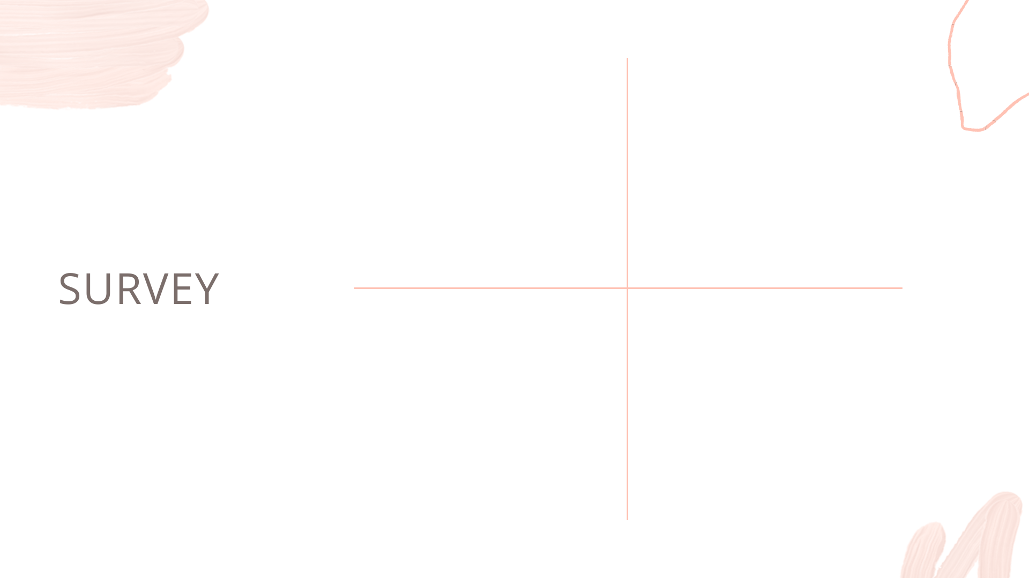
11 interviewees total:
6 female, 5 male
Age Range:
19 - 27
INTERVIEW
demographics
Employment Status:
10/11 Interviewed were
unemployed
Student Status:
8/11 of those interviewed are students
at UIUC
Notes:
Replace ethnicity

Slide 5

What Did We Ask?
What is the first thing that comes into your mind when you hear the word “period?”
What do you think about the tampon tax? What do you think should be done to make period products more affordable?
Have you seen others that have struggled with accessibility? What did you observe?
What were the worst things you faced, and what did you wish could happen to make your experience better?
How would you improve accessibility for those who cannot access it? How do you think we can help those who cannot afford period products? (Period Poverty)
What do you think about the stigma about menstruation, and the way society thinks about it in general?

Slide 6

Why?

Slide 7
We wanted to learn more about the way people thought about periods, as well as the accessibility of sanitary products in society.

Slide 8

Extremes
A young mother of multiple children
The homeless
Transgender men
Individuals who suffer from endometriosis or unusually heavy periods

Slide 9
Why were they extremes?

Slide 10
What is the first thing that comes into your mind when you hear the word “period?”
“Misogyny”
“Ughh why does it have to come every month. Pain. Blood, so much blood. Pads, tampons, mood swings maybe.”
“Pain, Blood, Hell, Suffering”
“My girlfriend in pain and mood swings.”

Slide 11
What are some things you wish you knew or learned about periods and questions that you have about it?
“I think I know more than I need to know about it (grew up in a family of 7 women so I know a lot of basics) and went to school that has a sex ed class..”
“What’s the average amount of blood a girl lets out per day during her menstruation cycle?”
“I wish I was aware of the physical and emotional effects of periods on women.”

Slide 12
What is your personal experience with accessibility, is it easy access for you? In a perfect world, how would you improve accessibility for those who cannot access it? How do you think we can help those who cannot afford period products?
“Financially, I am able to get period products whenever I need. However, being a trans man, I am sometimes uncomfortable buying them as it causes dysphoria. In addition, there is never anywhere in men's restrooms to dispose of used products. To increase accessibility, period products should not be taxed, and should be given out for free at schools, universities, hospitals, or other public spaces.”
“Period accessibility is easy for me, I can just go to a store and buy some products. But for women that are financially unstable, it would be very difficult to either find donations of feminine products or to even purchase them. Feminine products should be cheaper, perhaps remove the tax on the products.”
“In a perfect world, I wouldn’t need to go around asking my friends for their pads (that they are happy to give me since they understand) but they also paid for or their parents paid for. Why can’t I just go to a bathroom stall and get a pad. I don’t always have quarters on me. I don’t even have cash on me in general to be honest. Who does anymore?!”

Slide 13
Can you share the problems you faced when you go through your period? What were the worst things you faced, and what did you wish could happen to make your experience better?
“As a trans man, having a period is very dysphoria-inducing. The language around having periods is always very women-focused and ignores any trans/nonbinary people who have periods, which makes it very difficult for me to talk about having a period without being seen as a woman.”
“Please have more empathy. Understand that it’s a natural phenomenon, address both the physical pain and emotional needs.”
“If I could ignore it I would. I used to get really bad cramps but ever since I started birth control, that helped with it a lot, but then again I still have to pay for birth control so you know, that’s fun. I just wished that it wasn’t such a hassle sometimes to clean up, find a pad, find a bathroom, etc. It’s like you can’t time the damn thing. Have you ever seen the Koolaid man? Yeah. That’s your period. Fun stuff. Not sure how to improve that since it’s biological you know?“

Slide 14

After analyzing what we collected from each interview, we narrowed down our target audience to college students who struggle with access to feminine hygiene products.

Slide 15

CON
CLU
SION
We need to find ways for those who struggle financially to have more accessibility
Next step - Reaching out to more extremes: find ways to get to homeless shelters and speak to women’s resource centers
Further conduct analysis on the responses we received from those who do not experience periods to see how we can improve education on periods

Slide 16

Questions?

